Slide 1

Batch Normalization
Why does
Batch Norm work?
deeplearning.ai

Slide 2
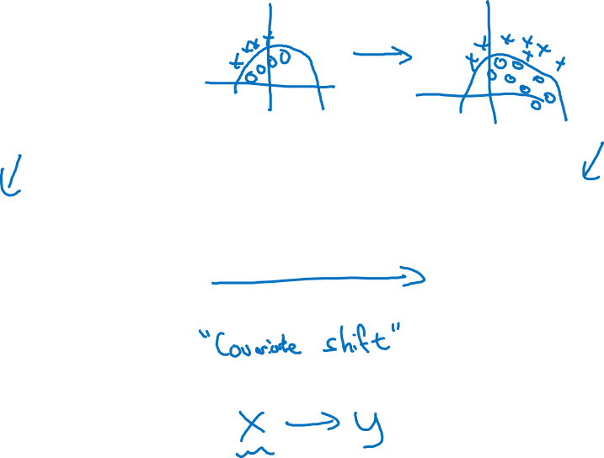
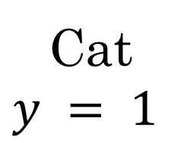
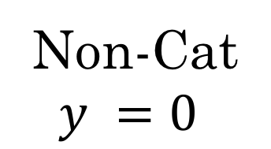
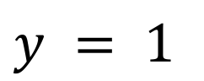
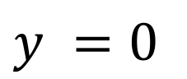

Learning on shifting input distribution
$x_{1}$
$x_{2}$
$\hat{y}$
$x_{3}$
Cat
Non-Cat
$y=1$
$y=0$

Slide 3
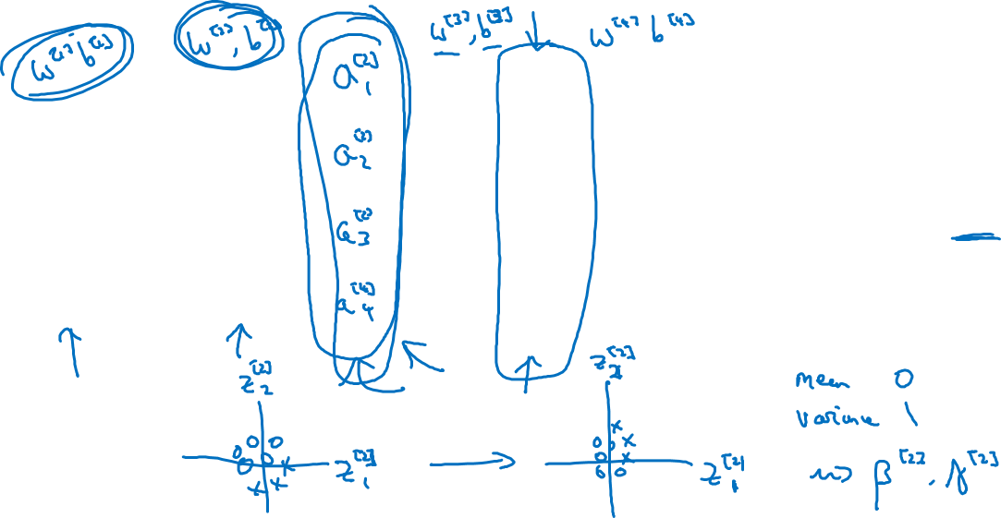
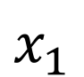
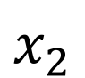
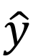
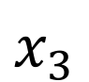
Why this is a problem with neural networks?
$x_{1}$
$x_{2}$
$\hat{y}$
$x_{3}$

Slide 4
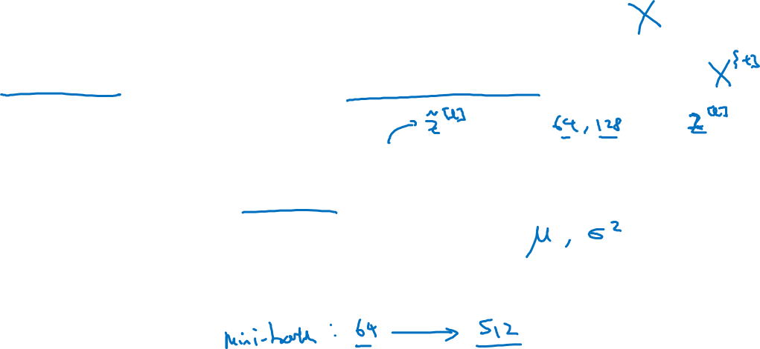
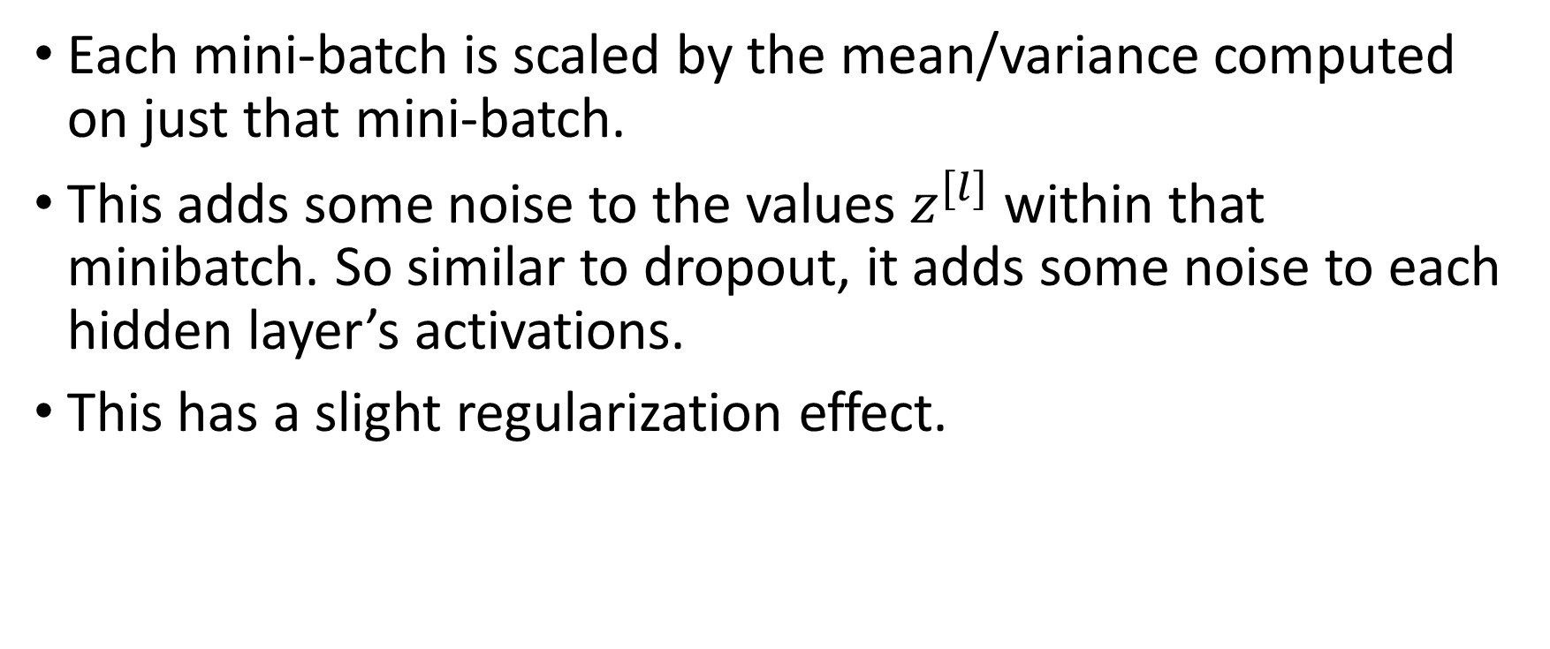
Batch Norm as regularization
Each mini-batch is scaled by the mean/variance computed on just that mini-batch.
This adds some noise to the values within that minibatch. So similar to dropout, it adds some noise to each hidden layer’s activations.
This has a slight regularization effect.

